Slide 1
Data Analysis: Red Bull Account Sales

Slide 2
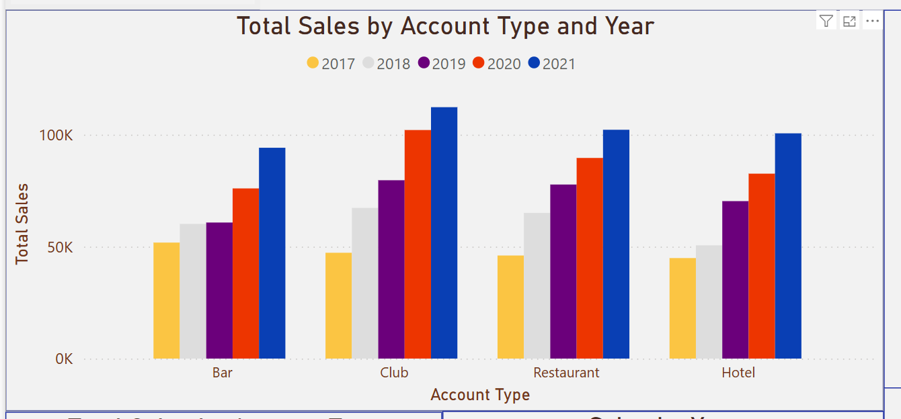
Sales Growth by Account Type and Year
This graph shows four main account types and their sales growth.
Year 2021 has shown the highest growth in sales compare to other years
Bars seem to have lowest sales compare to other account types.
Night Clubs are making good sales in 2019,2020 and 2021.

Slide 3
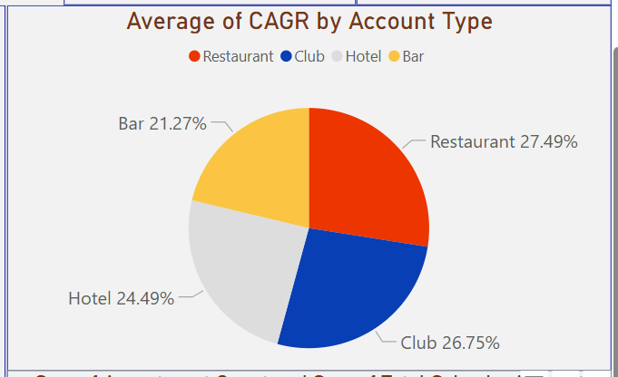
Best and Worst Performing Accounts by Account Type (5 Year CAGR)
This Pie chart shows four main account types and their CAGR.
Restaurants have highest CAGR among other account types.
Bars have the lowest CAGR which need stakeholder’s attention.

Slide 4
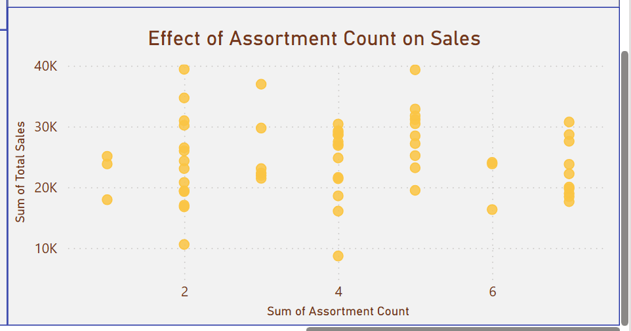
Assortment Count Effects on Sales
No clear positive correlation between Assortment count and Total Sales.
Accounts with lover assortment count can often achieve higher sales.
Focus must be on the top achieving assortment not at the variety.

Slide 5
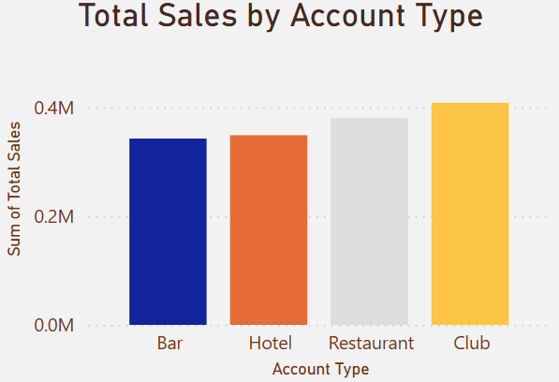
Total Sales by Account Type
In this Bar Chart it shows that the Nightclubs have the most highest sales (0.4M) in the past years and Bars have the lowest sales.
Invest more in the Bars and Hotel and study their strategy to improve their sales.

Slide 6
Observations and Key Takeaways
Overall, the Nightclubs and restaurants are most performing accounts and generating sales of $800,000 in the past years while the Bars and Hotels are least performing accounts.
A good strategy on management should be applied on the least performing accounts for them to reach their potential.
Restaurants and Nightclubs are the top-performing accounts indicating the strong customer demand as well as Restaurants and Nightclubs have the highest Compound Annual Growth Rate (CAGR) compare to other account types.
Accounts must focus on the top performing assortments not the at the variety as lower sums of assortment have showed a good sales compare to other higher sums.

